Slide 1
How to remain Anonymous

Slide 2
Steps
Configuring Proxy
Configuring VPN
Changing MAC address
Auto Shell Programs

Slide 3
Setting the host name
We can change the hostname from kali to windows manually.

Slide 4
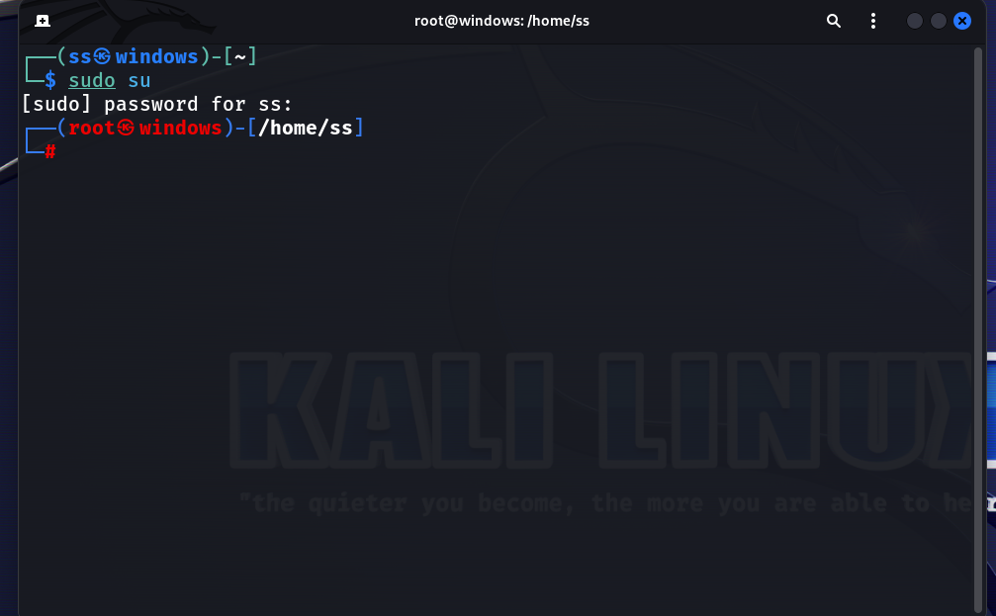
Step 1: Give root permission

Slide 5
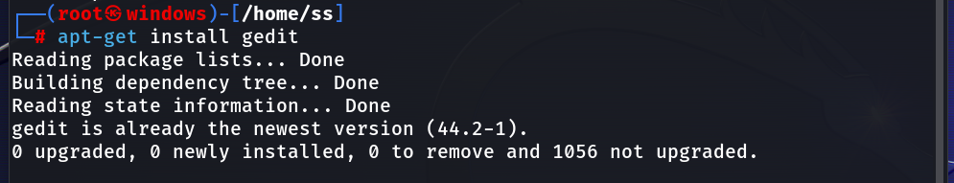
Step 2: install Gedit
apt-get install gedit

Slide 6
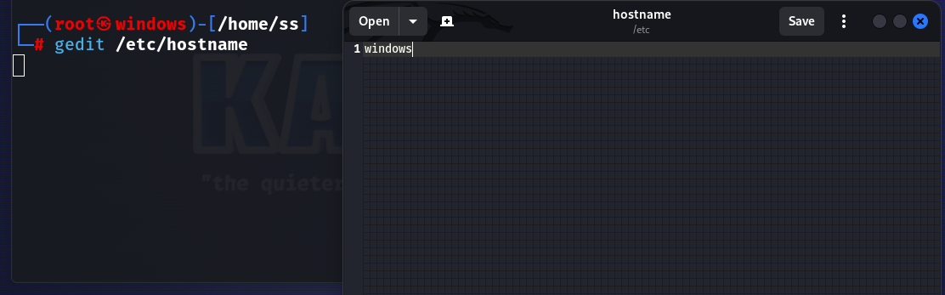
Step 3:
gedit /etc/hostname

Slide 7
Step 4: check hosts file
gedit /etc/hosts

Slide 8
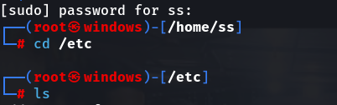
Step 5: changing to proxy browser

Slide 9
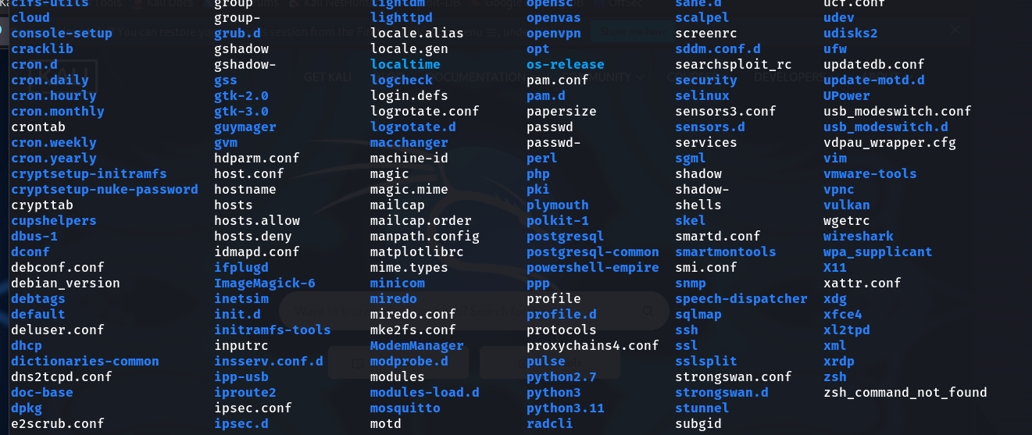

Slide 10
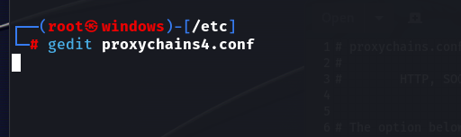

Slide 11
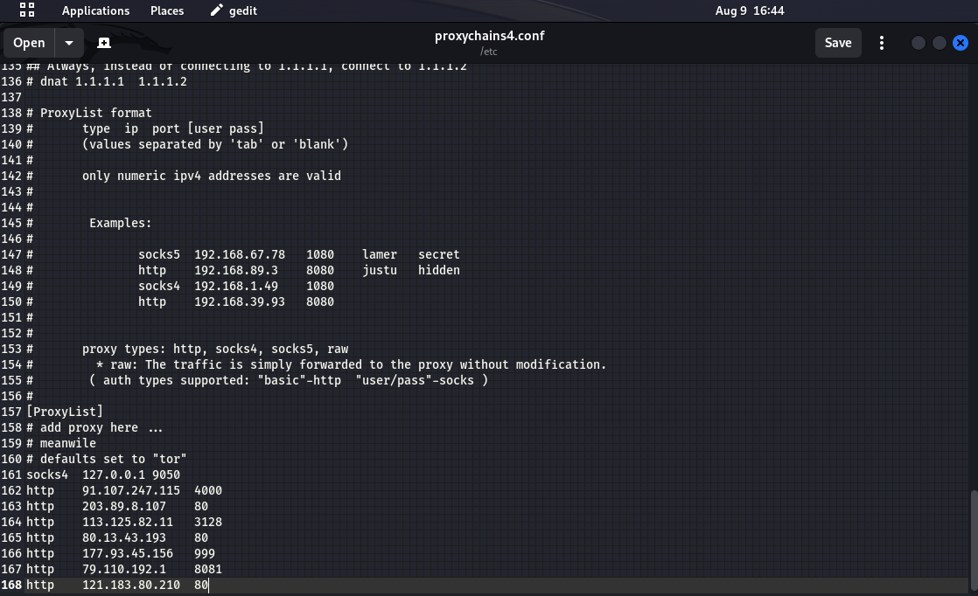

Slide 12
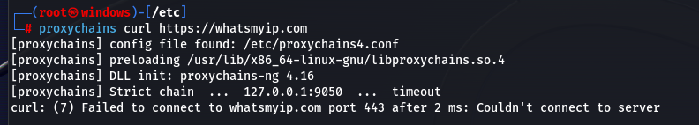
Step 6:
curl: curl (short for "Client URL") is a command line tool that enables data transfer over various network protocols.
It communicates with a web or application server by specifying a relevant URL and the data that need to be sent or received.
ProxyChains is a tool that redirects TCP connections made by applications, through various proxies like SOCKS4, SOCKS5, or HTTP
proxychains curl https://whatsmyip.com

Slide 13
Virtual private network
A virtual private network, or VPN, is an encrypted connection over the Internet from a device to a network.
The encrypted connection helps ensure that sensitive data is safely transmitted.
It prevents unauthorized people from eavesdropping on the traffic and allows the user to conduct work remotely.

Slide 14
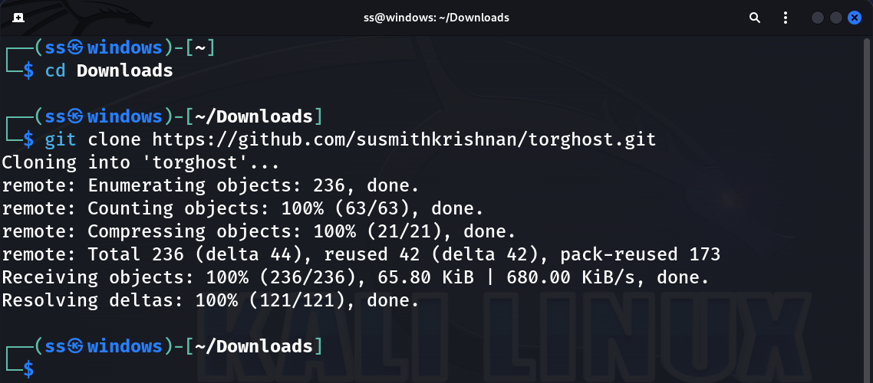


Slide 15

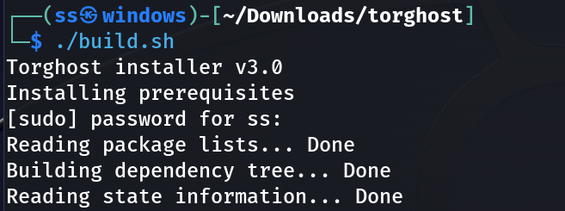
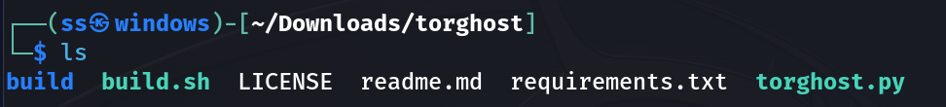

Slide 16
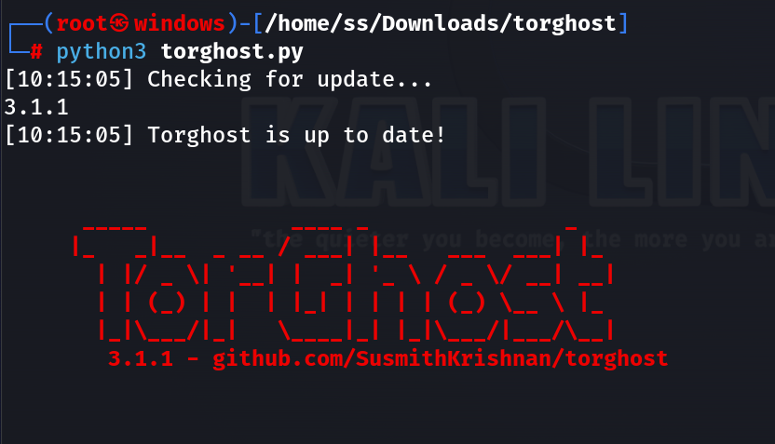
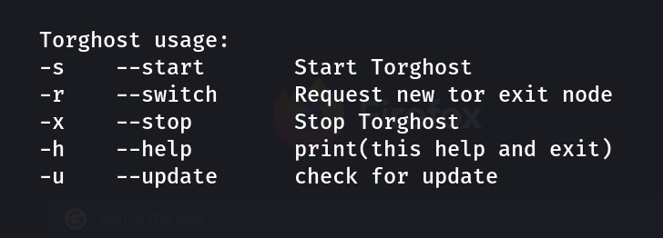

Slide 17
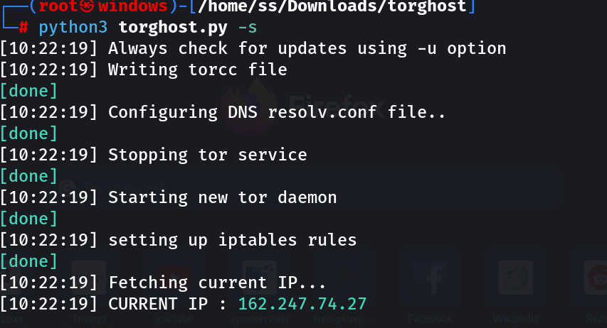

Slide 18
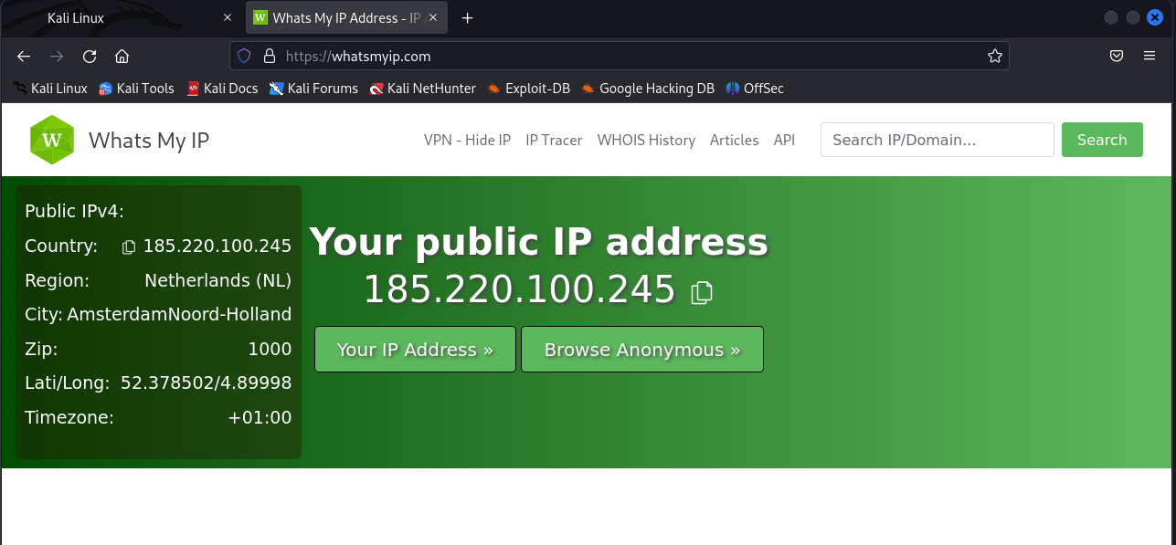

Slide 19
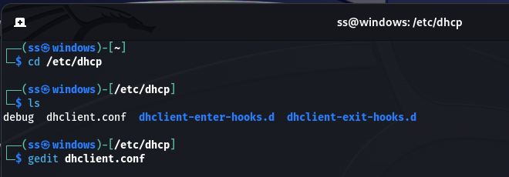
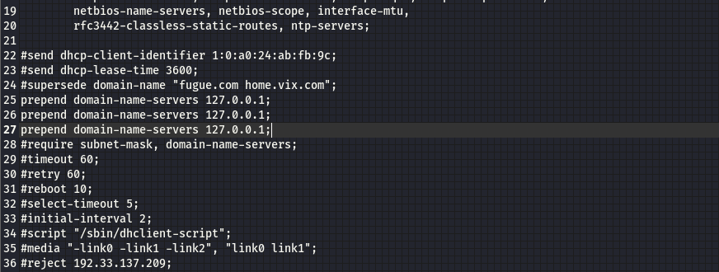
Configuring VPN

Slide 20
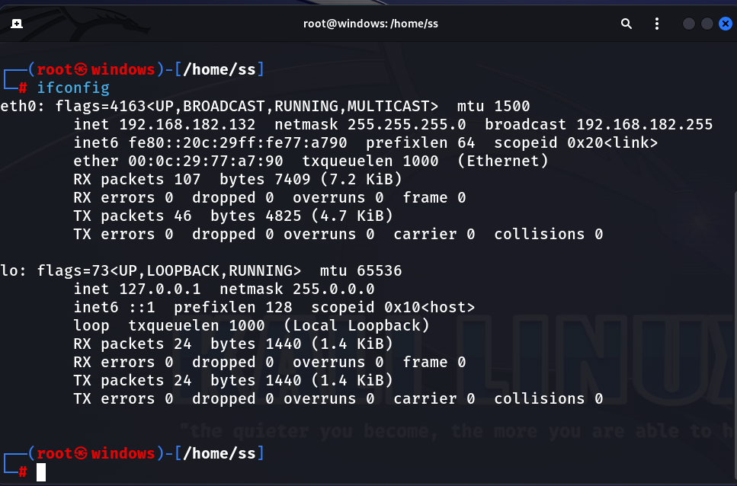
Changing MAC address
ipconfig

Slide 21
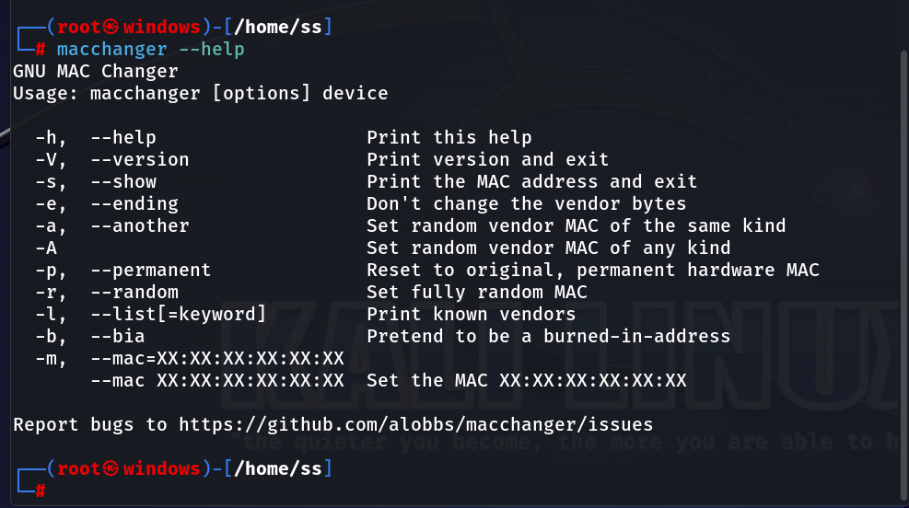
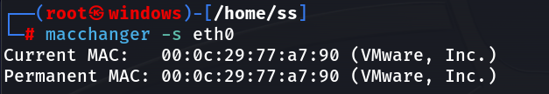

Slide 22
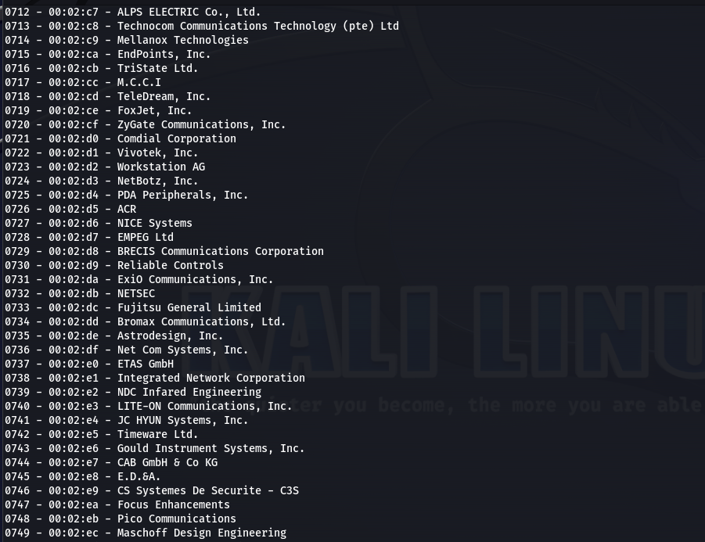
Print Known Vendors MAC address
macchanger -l

Slide 23
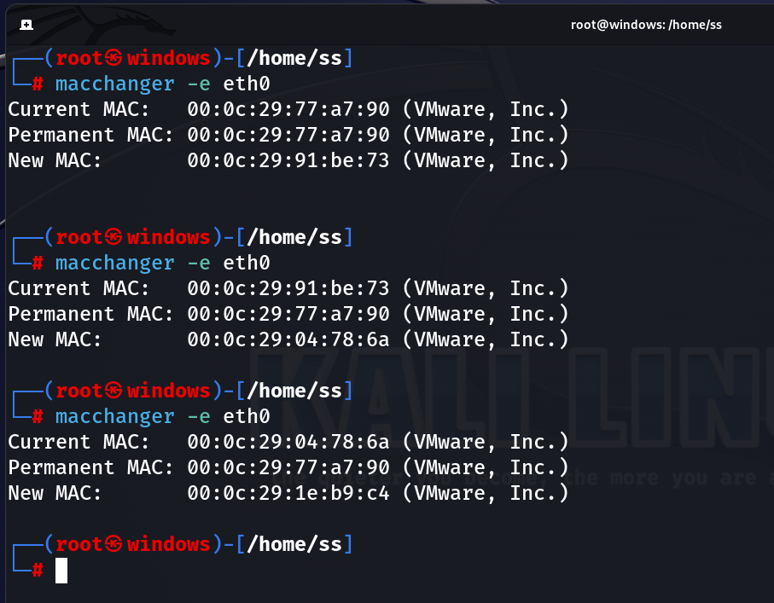

Slide 24

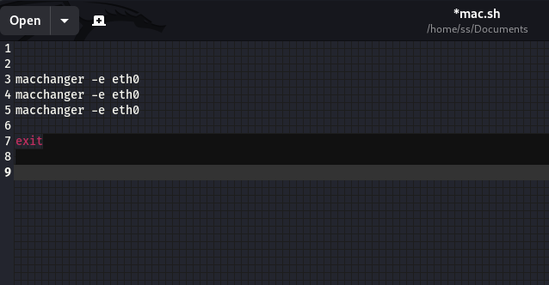
Change Mac address while you reboot

Slide 25

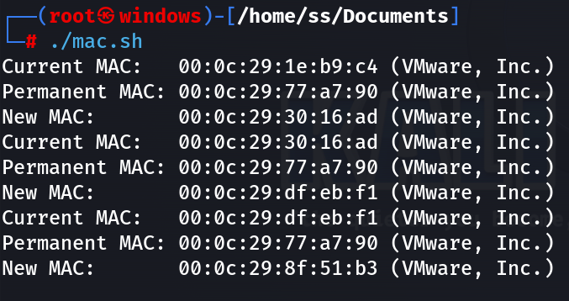

Slide 26
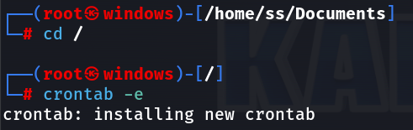

Slide 27
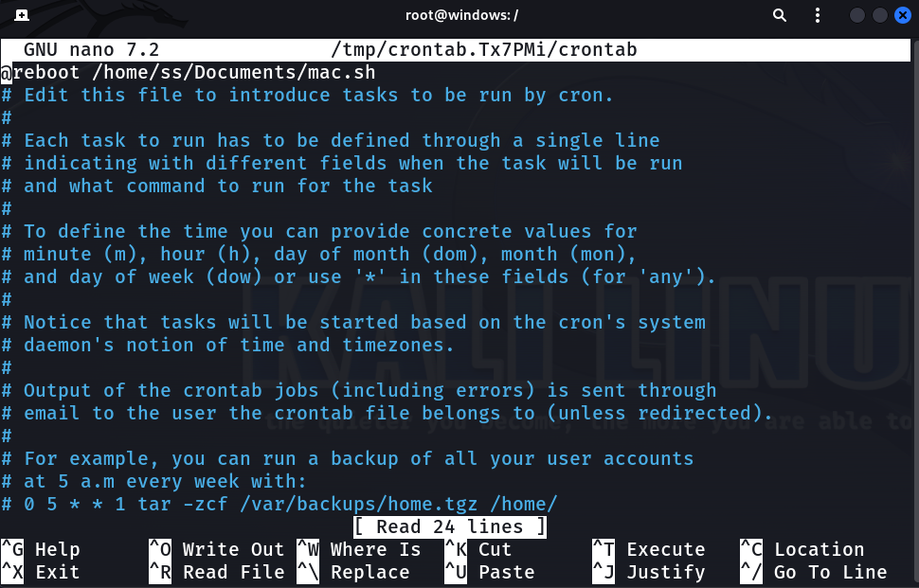

Slide 28
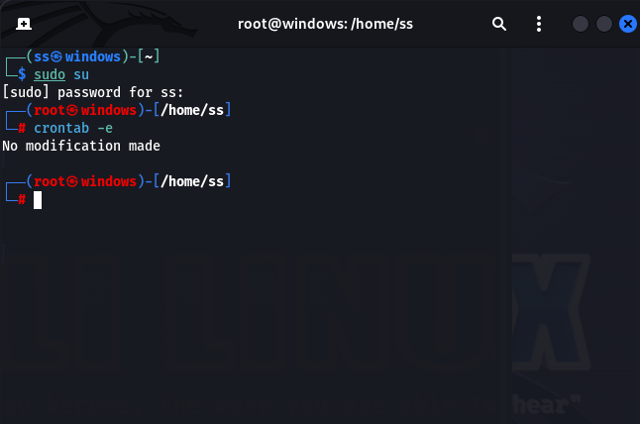
Take a New Terminal

Slide 29
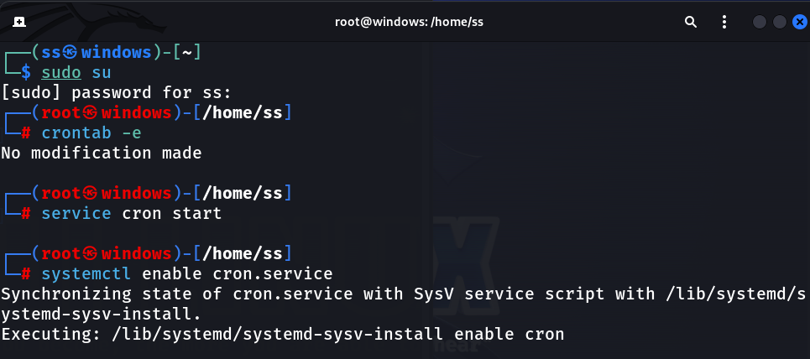

Slide 30
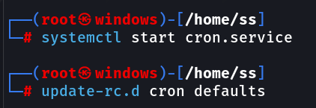
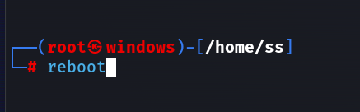

Slide 31
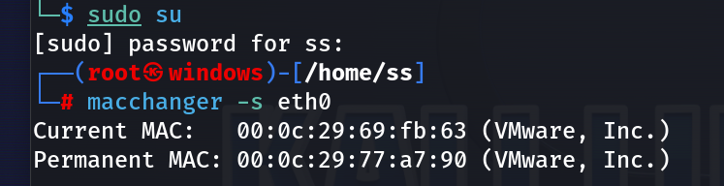

Slide 32
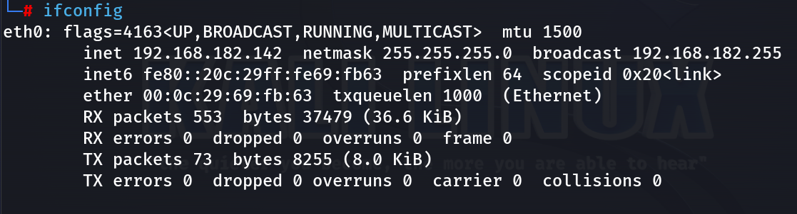
Changing the MAC address of Internet Connection

Slide 33

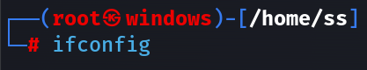
First close the connection to avoid misconfiguration
Ifconfig eth0
No configuration displayed

Slide 34
